Slide 1
ICT & Software Engineering
01 - Classes & objects
Introduction to Visual Studio & C#

Slide 2

Content
Topics of this lecture
Introduction to PCS
Intro to C#
Intro to C# - Continued
Crash course of C#

Slide 3
Intro
Programming in C# (PCS) exists out of two parts
Intro to Classes & Object (OO) 2 x 1.5 hours of lectures 1 x 1.5 hours of supervised practice
Focus: Object Oriented Programming
Practical: Quiz questions and practice assignments
Windows Form Apps & Misc. (WF) 2 x 1.5 hours of lectures 1 x 1.5 hours of supervised practice
Focus: .NET Core, GUI & IDE
Practical: Practice assignments
Presentations & practical available in Canvas
Object & Classes lessons are prefixed with OO Windows Forms lessons are prefixed with WF

Slide 4
Intro: Feedback
Informal feedback When working on practice assignments you can (& are expected) to ask for feedback. The feedback is for your learning process.
When: during scheduled classes
Purpose: get information/help/tips about how you implemented the assignment
Formal feedback During set weeks you are required to show your work for feedback and it will be registered in Canvas as a formative indication.
When: Week 12, 15 & 18
Purpose: get an understanding about how your current proficiency is
Both are considered during the assessors meeting
This also functions as a way for your teachers to get an impression of what your proficiency is

Slide 5

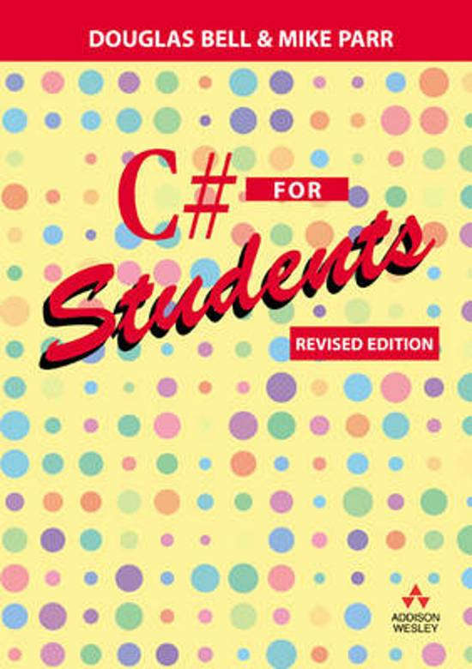
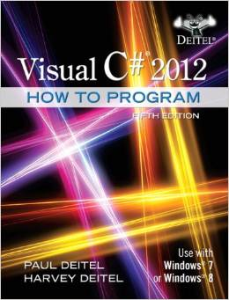



Resources
Resources:
Book C# for Students, by Douglas Bell and Mike Parr
Book Visual C# 2012, How To Program (Fifth Edition), by Paul Deitel & Harvey Deitel
Website Microsoft Docs (https://docs.microsoft.com/en-us/dotnet/csharp/)
Internet tutorials (e.g. Youtube)
Tool: Microsoft Visual Studio Enterprise

Slide 6
Microsoft Visual Studio Enterprise
Go to Sharepoint - Student Square
Click on the link Azure Dev Tools for Teaching (Imagine)
Log on with your Fontys-account
Look for Visual Studio Enterprise and download it (free)
Be sure to take note of the serial key!
Install Microsoft Visual Studio software
Install before lecture of Object Oriented Programming - Windows Forms!

Slide 7
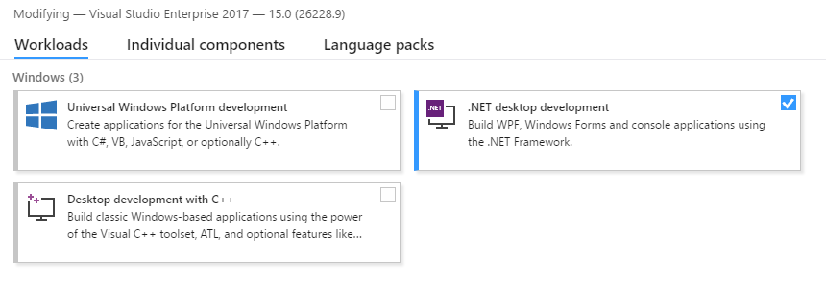
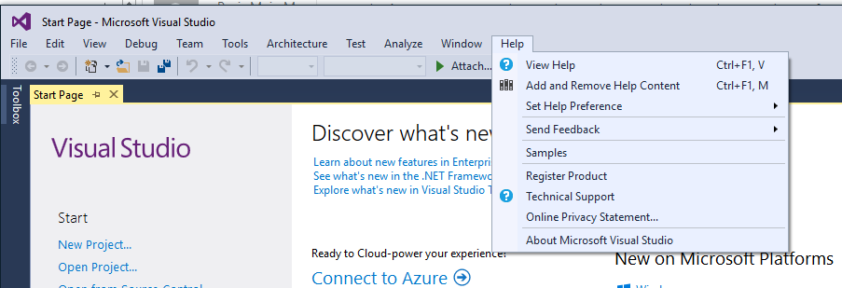
Installing Visual Studio

Slide 8
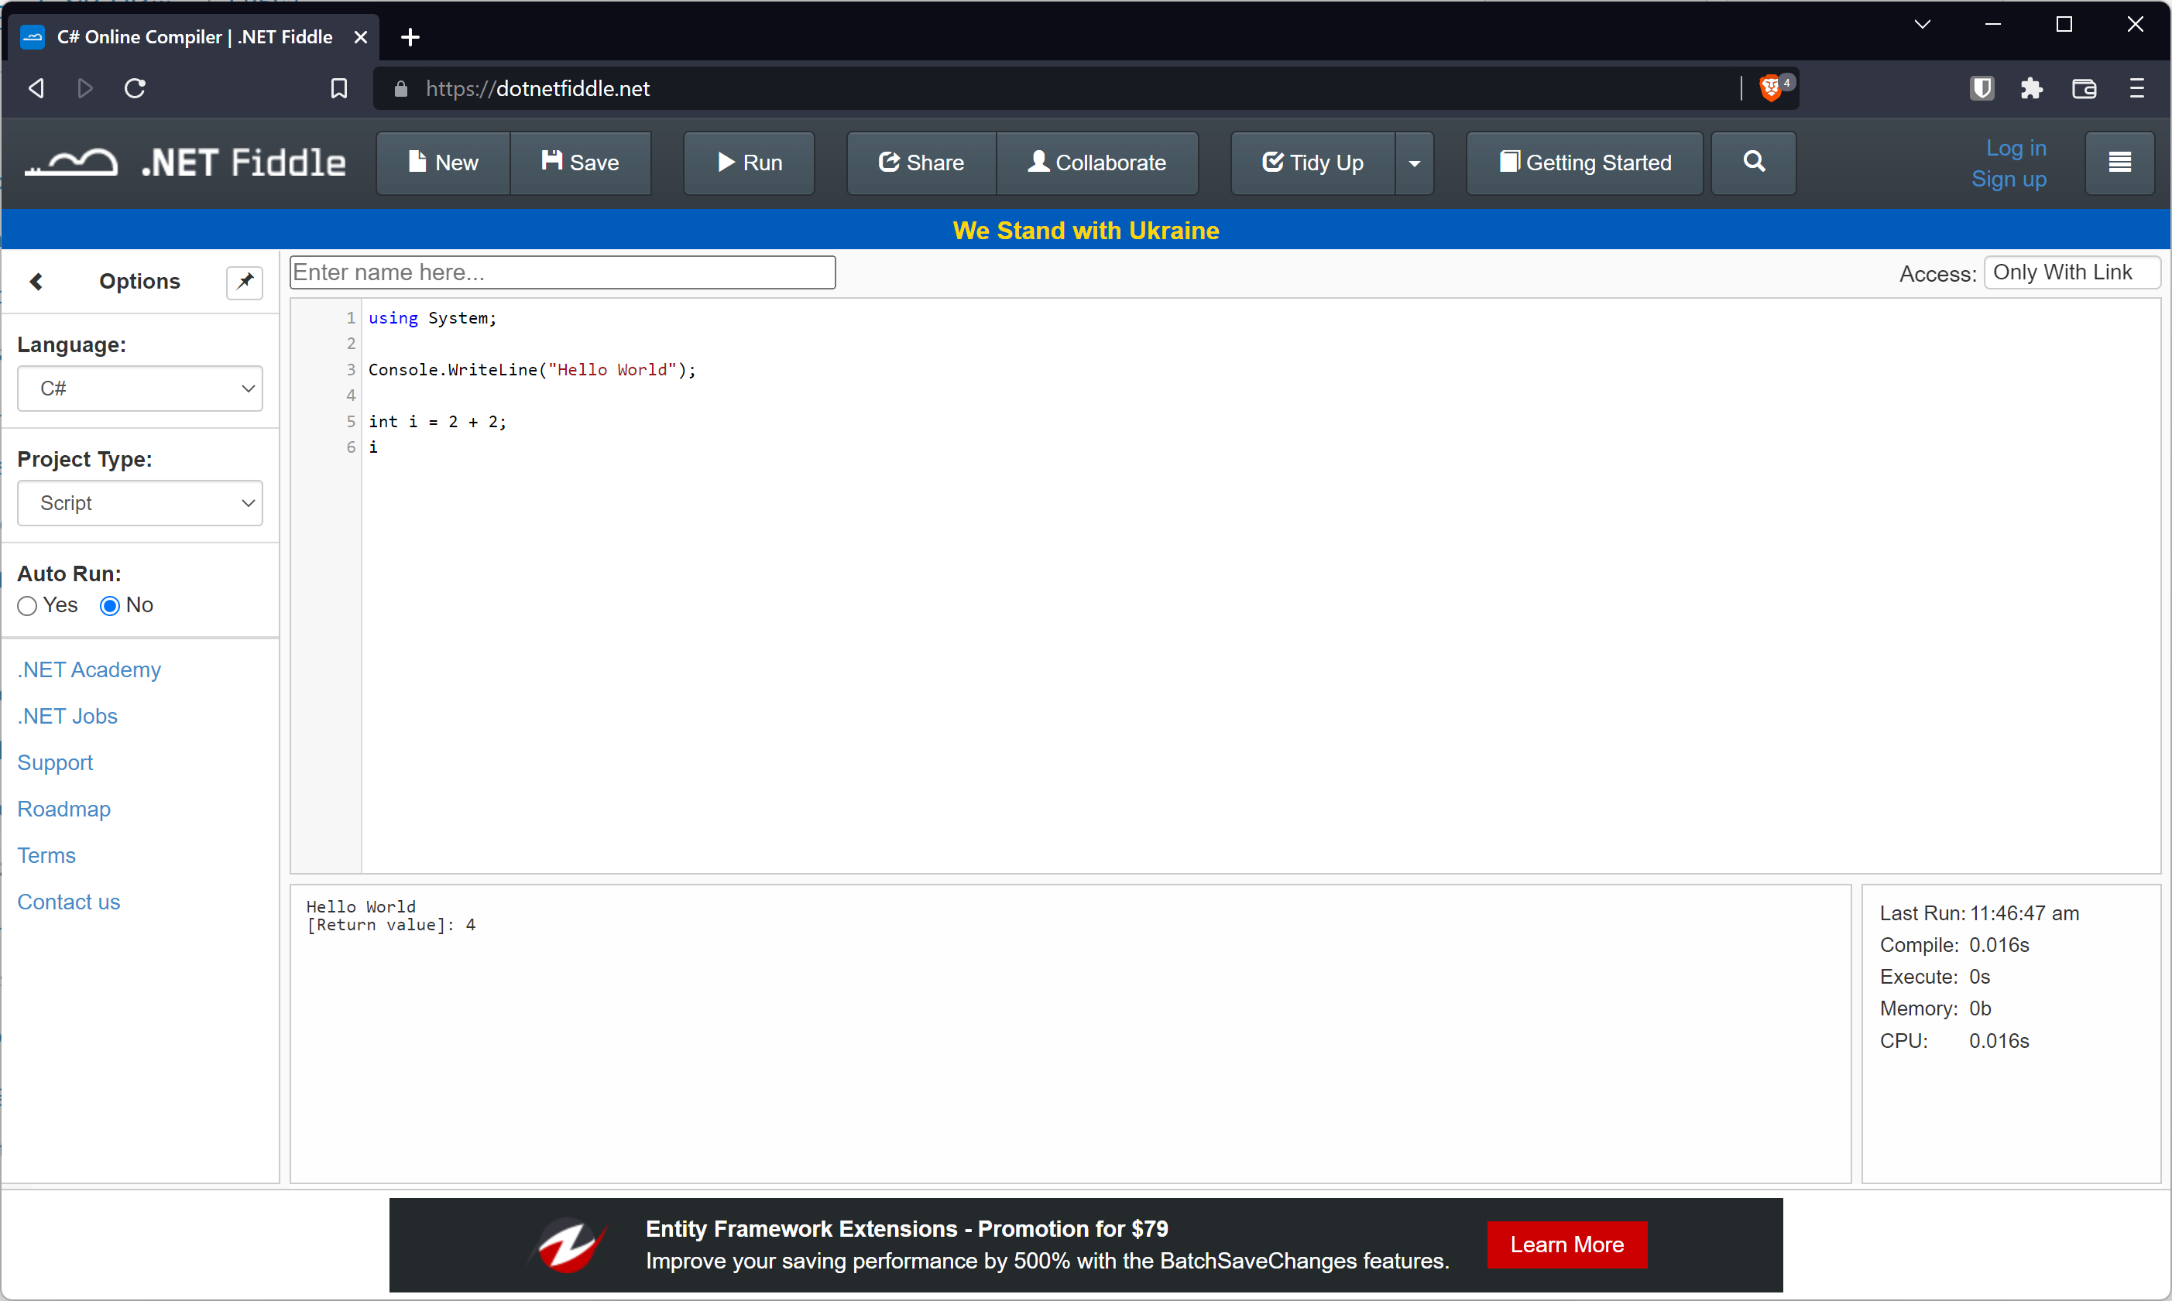
Online C# REPL
For today we use https://dotnetfiddle.net/

Slide 9

Questions?

Slide 10
Intro to C# (C sharp)
.NET Framework

Slide 11
Intro
Learn programming concepts and when/how to apply them!
Remainder of this semester (and next semester):
Object Oriented Development
‘Tool’: .NET (Core) with the language C# and Windows Forms Applications

Slide 12
Python vs C# (for now)
Biggest difference: C# is a strongly typed programming languages
Other notable differences:
; (semi-column) at the end of statements
{} (curly brackets) to determine code blocks!
For example:
public Song GetSong(string query)
{
Song foundSong = null;
foreach (Song s in this.songs)
{
if (s.GetTitle().Contains(query)) { foundSong = s; }
}
return foundSong;
}

Slide 13
Python vs C# (for now)
public Song GetSong(string query) {
Song foundSong = null;
foreach (Song s in this.songs) {
if (s.GetTitle().Contains(query)) {
foundSong = s;
}
}
return foundSong;
}
Biggest difference: C# is a strongly typed programming languages
Other notable differences:
; (semi-column) at the end of statements
{} (curly brackets) to determine code blocks!
For example:
‘Same’ code
public Song GetSong(string query)
{
Song foundSong = null;
foreach (Song s in this.songs)
{
if (s.GetTitle().Contains(query)) { foundSong = s; }
}
return foundSong;
}

Slide 14
Concepts
Types
Simple types
List<T>
Array
Operators
Arithmetic operators
Relational operators
Conditional statements
if-statement
Repetition statements
for-statement
while-statement
foreach-statements
Arrays will be covered separately during part 3 of this lecture

Slide 15
Simple Types
C# is a strongly typed language and there are built-in types. For now we use simple types:
Type | Description | Literal values
int | Numbers without decimals (integers) | -5; 0; 124
string | Text | "students"; ""
float | Numbers which may or may not contain decimals | 124f; 1254.65f
double | Numbers which may or may not contain decimals Double is more precise than float (64 bits) | 124; 1254.65
decimal | Numbers which may or may not contain decimals Decimal is more precise than double (128 bits) | 18.8m
bool | Boolean values | true; false

Slide 16
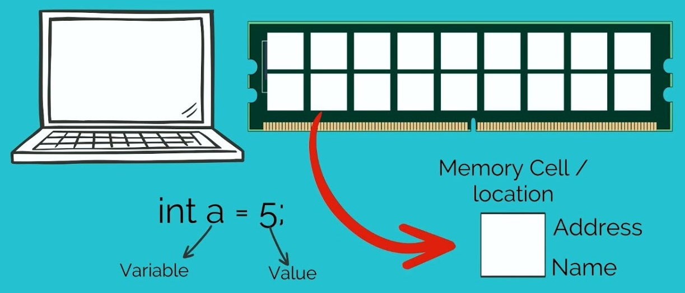
Variables
C# expects you to first declare a variable before using it
This means:
First declare with a type and identifier
Optional: initialize variable with a value
Assigned value must match variable type

Slide 17
Variables: Examples
int age;
string name = "Bob";
age = 18;
int a, b, c;
a = 10; b = 20; c = 30;
a = b + c; //a has now value 50
a = a + 1; //a has now value 51
bool youAreYoung;
youAreYoung = true; //true

Slide 18

Variables: Syntax
Variable declaration:
Variable assignment:
Variable declaration and assignment of value:
<type> <identifier>;
<identifier> = <value_or_expression>;
<type> <identifier> = <value_or_expression>;

Slide 19
Arithmetic Operators
Math operators for numeric values
 | Operator | Example effect as
Addition | + | int x = 5 + 2;
Subtraction | - | int y = 6 – 10;
Multiplication | * | double z = 5 * 0.5;
Division | / | double x = 5 / 2;
Remainder | % | int y = 5 % 2;

Slide 20
Variables & Arithmetic Operators
Operation precedence
Programming variable ≠ Math variables
Operators | Associativity
* / % | left to right
+ - | left to right
= | right to left
// Valid code but invalid math
int age = 5;
age = 20;
age = age / 2;

Slide 21
Variables: Numeric examples
int flupke = 67;
// a variable declaration followed by an assignment
flupke = 4.63; // oops! not possible!
double quick = 7.56;
quick = flupke + 4.63; // yes, is possible.
// flupke is automatically converted to a double
quick = 4,63; // oops! not possible!

Slide 22
Questions?

Slide 23
Extra information (1/2)
Give descriptive names to variables for readable code
Sometime you want to change between types.
Convert between string and int
Convert has options for all the different types
int age = Convert.ToInt32("12");

Slide 24
Extra information (2/2)
Ambiguity of + operator
int division
int x = 67; double y = 50;
double intResult = x + y; // What would the value of intResult be?
string a = "67"; string b = "50";
string stringResult = a + b; // What would the value of stringResult be?
int x = 5; int y = 2;
int divisionResultA = x / y; // What would the value of divisionResultA be?
double divisionResultB = x / y; // What would the value of divisionResultB be?

Slide 25
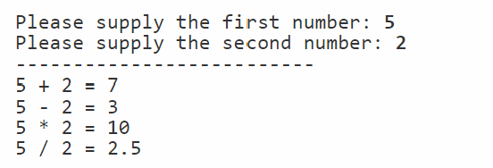
Demo
Via https://dotnetfiddle.net/
Simple calculator getting input for two numbers
Perform arithmetic operations with numbers
Extra: show case + operator with strings
Note that Console.ReadLine() & Console.WriteLine() used in the demo is only till you start working with Windows Forms App

Slide 26
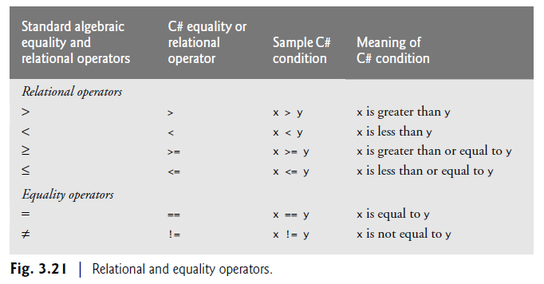
Intermezzo: Relational operators
Comparing values with each other
// Soem examples
bool isEighteenorOlder = age >= 18;
bool sameName = name == "John Doe";

Slide 27
Control statements
And list

Slide 28
If-statement: Example
Control which code-blocks are going to be executed
if ( age >= 18 )
{
//age is 18 or heigher
}
if ( name == "John Doe" )
{
// value of name is John Doe
}
else {
// value of name is not John Doe }
if ( age > 17 )
{
//age is 18 or heigher
}

Slide 29
If-statement: Syntax
Control which code-blocks are going to be executed
if ( <boolean_expression> )
{
//if boolean expression
//evaluates to true
<statement(s)>
}
if ( <boolean_expression> ) {
<statement(s)>
}
else if( <boolean_expression> ) {
//if first boolean expression
//evaluates to false
<statement(s)> } else {
//if second boolean expression
//evaluates to false
<statement(s)> }
if ( <boolean_expression> )
{
<statement(s)>
}
else {
//if boolean expression
//evaluates to false
<statement(s)> }

Slide 30
Logical operators (1/2)
bool p = true; bool q = false;
Logical Operator | C# Operator | C# expression | Meaning
Conditional And | && | p && q | True if both of its operands are true (stops if p is false)
Conditional Or | || | p || q | True if either of its operands is true (stops if p is true)

Slide 31
Logical operators (2/2
bool p = true; bool q = false;
Logical Operator | C# Operator | C# expression | Meaning
Conditional And | && | p && q | True if both of its operands are true (stops if p is false)
Conditional Or | || | p || q | True if either of its operands is true (stops if p is true)
Logical Negation | ! | !p | Reverse the meaning of p

Slide 32
Logical operators: Examples
Control which code-blocks are going to be executed
if ( age >= 18 && age < 30 )
{
//age is 18..29
}
if ( name != "John Doe" )
{
// value of name is not John Doe
}
else {
// value of name is John Doe }
if ( age < 18 || age > 29 )
{
//age is 17 or lower or 30 or heigher
}

Slide 33
Questions?

Slide 34
Practice
Go to https://dotnetfiddle.net/
Create a BMI Calculator: BMI = weight / ( height²), where weight is in kilograms and height is in meters.
Request required data and then show the explanation to the user:
Body mass index | explanation
bmi < 18,5 | underweight
18,5 <= bmi < 25,0 | normal weight
25,0 <= bmi < 30,0 | overweight
bmi >= 30,0 | obese
Note that Console.ReadLine() & Console.WriteLine() used in the demo is only till you start working with Windows Forms App

Slide 35
Intermezzo: List
Comparable with Python’s List
List<string> names;
names = new List<string>();
names.Add("John Doe");
names.Insert(0, ("Janet McZane");
string name = names[1]; // John Doe
names.RemoveAt(0);

Slide 36
Syntax: Declaration & Initialization
Declaration:
List<<type>> <identifier>;
Initialization:
<identifier> = new List<<type>>();
Declararion and initialization:
List<<type>> <identifier> = new List<<type>>();

Slide 37
Syntax: Addition & Removal
Add new element:
<identifier>.Add(<element>);
Insert new element inside list:
<identifier>.Insert(<int>, <element>);
Remove element by value:
<identifier>.Remove(<element>);
Remove at specific index:
<identifier>.RemoveAt(<int>);
Clear the entire list:
<identifier>.Clear();

Slide 38
Syntax: Other operations
Retrieving element at index:
<listType> elementAtIndex = <identifier>[<int>];
Find index of element:
int indexOfElement = <identifier>.IndexOf(<element>);
Check if value is in list:
bool elementInList = <identifier>.Contains(<element>);
Amount of elements in the list:
int elementCount = <identifier>.Count;

Slide 39
Questions?

Slide 40
While-statement
Also called condition
Syntax:
Example:
while (<boolean_expression>)
{
<statements>
//To exit the loop, the condition should evaluate to false
}
int sum = 2;
while (sum < 100)
{
sum = sum * 3;
}

Slide 41
Intermezzo: Arithmetic operators cont.
Compound assignment:
Increment and decrement:
Operator | Example | Same effect as
+= | x += 2; | x = x + 2;
-= | y -= 10; | y = y – 10;
*= | z *= 3; | z = z * 3;
/= | x /= 2; | x = x / 2;
%= | y %= 2; | y = y % 2;
Operator | Example | Same effect as
++ | x++; | x = x + 1;
++ | ++x; | x = x + 1;
-- | x--; | x = x - 1;
-- | --x; | x = x - 1;

Slide 42
For-statement
Syntax:
Example:
for (<initialization_part>; <continuation_condition>; <action_after_each_iteration>)
{
<statements>
//To exit the loop, the condition should evaluate to false
}
int sum = 0;
for(int counter = 0; counter <= 10; counter++)
{
sum += counter;
}
int sum = 0;
for(int i = 25; i > 5; i -=3)
{
sum += counter;
}

Slide 43
Questions?

Slide 44
Foreach-statement: Intro
Different loop for going through all values in a collection
for(int i = 0; i < listOfNames.Count; i++)
{
string name = listOfNames[i];
// Do something with name
}
foreach(string name in listOfNames)
{
// Do something with name
}

Slide 45
Foreach-statement: Intro
foreach(string name in listOfNames)
{
// Do something with name
}
listOfNames
"John" | "Maria" | "Donald" | "Eve" | "Pip"
name

Slide 46
Foreach-statement: Syntax
Syntax:
foreach (<type> <identifier> in <collection>) { <statement(s)> }
Example:
string searchForName = "John";
foreach (string entry in listOfNames) { if (entry == searchForName ) { // Do something with found result } }

Slide 47
Questions?

Slide 48
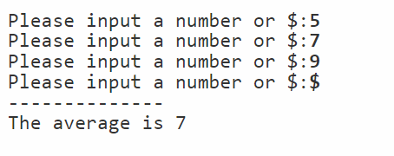
Demo/Practice (together)
Via https://dotnetfiddle.net/ create an app to calculate the average of inputted numbers
Request to input n numbers (n is a fixed amount); which loop would you use? then refactor to
Request to input numbers until user inputs $; which loop would you use?
What would you use to store all the inputted numbers?
Calculate average of all numbers with a loop; which one would you use and how can we do this?
Note that applying a loop-stament to get input is for REPL script/console application. You should do this in a Windows Forms App.

Slide 49
What is next
Continue practicing with C#!
See in Canvas/Git for the practice assignments
Do the quiz questions revisit the concepts
Do the exercises for hands-on experience
Programming is a practical skill; you only truly learn it by doing it!
Ask for clarifications/feedback/help when in doubt

Slide 50
Part2 - Practical
See canvas/GIT for Quiz & practical assignments – Classes & Objects

Slide 51
Part 3
C# - Continued

Slide 52
Content
Topics of this lecture
Introduction to PCS
Intro to C#
Intro to C# - Continued

Slide 53
Questions?
Types
Simple types
List<T>
Operators
Arithmetic operators
Relational operators
Conditional statements
if-statement
switch-statement
Repetition statements
for-statement
while-statement
foreach-statements

Slide 54

Array: intro
How does List<T> work/what is it?
Simplified explanation
Build-in .NET Complex Type (actually a class) that functions as a ‘wrapper’ around an array.
List
Array
Add value to list

Slide 55
Array: Example
An array is an ordered sequence of variables of the same type
Referenced by the name of the array
Each variable can be accessed by the name of the array and an index
double[] grades; // declares a variable; no array yet
grades = new double[5]; // creates an array to store 5 doubles
grades[0] = 7; // the first element is on index 0
grades[1] = 5;
grades[2] = 8.4;
grades[3] = 9;
grades[4] = 6.5; // the last element is on index 5-1
// now elements of the array grades are: 7, 5, 8.4, 9 and 6.5

Slide 56
Array: Syntax
<type>[] <array_identifier>; //declare an array
// creates an array, big enough to store <array_size> elements;
// all elements initialized with bytes 0.
<array_identifier> = new <type>[<array_size>];
//assign elements to an array
<array_identifier>[<index>] = <value_of_same_type>;

Slide 57

Array: Example another way to create and initialize an array
String[] names = {"Sue", "Jane", "Ahmed", "Wayne"};
// first an array names is created, just big enough to store the elements as indicated between the curly brackets.
Then the array is initialized with the values as indicated between the curly brackets.
names
"Sue" | "Jane" | "Ahmed" | "Wayne"

Slide 58
Examples (cont.)
int[] X;
X = new int[7];
for(int i=0; i<7; i++)
{ X[i] = 2*i+1; }
// now the array X has elements 1, 3, 5, 7, 9, 11, 13
int sum = 0 ; // suppose we have an array X with at least 20 elements
for(int i=0; i<20 ; i++)
{
sum = sum + X[i];
} // sum has value X[0] + X[1] + . . . + X[19]

Slide 59

Extra information
Methods and attributes
grades.Length : the number of elements of the array grades
Array.Sort(grades): sorts all elements of the array grades
The index in an array always starts at 0.
int sum = 0 ; // suppose we have an array X
For (int i=0; i < X.Length ; i++)
{
sum = sum + X[i];
} // sum has value X[0] + X[1] + . . . + X['last index']

Slide 60
Questions?

Slide 61
Demo
Write an app that uses an array and list to hold the names of students in a PRJ group.
Challenges:
How ‘big’ should the array be?
How do we know at which element to save the name?

Slide 62
Situations in which arrays might be used:
Sometimes we have a fixed number of elements and they don't change. (Example: an array with the names of the months)
Sometimes we have a fixed number of elements. Each element of the array has a meaningful value and that value might change. (Example: first practicum assignment: an array to store how many of each coin we have in our money box. On forehand we know how many kind of coins we have.)
Sometimes we have a number of elements with a meaningful value. This number of elements might change. Also their values might change. (Example: an array to store the names of players of a team. Sometimes a new player joins the team so his/her name should be added; sometimes a player quit, so his/her name should be removed; sometimes we misspelled somebody's name so it need to be changed.)

Slide 63
Extra information
An out of range exception occurs when using an index that is not within the range of the array. Such an error will not be detected by the compiler but will occur at runtime when the program is executed.
double[] grades; grades = new double[5];
grades[0] = 7;
grades[1] = 5;
grades[7] = 6.5; // this statement results in an out of range exception. System.IndexOutOfRangeException

Slide 64
Extra information(cont.)
The index might be the outcome of an expression.
int[] X; X = new int[5]; // X has elements 0, 0, 0, 0, 0
int i = 2;
X[i+1] = 1; // X has elements 0, 0, 0, 1, 0
X[ X[i+1] ] = 7; // X has elements 0, 7, 0, 1, 0
X[ [i+4] ] = 8; // oops, index out of range ! ! !

Slide 65
Background info: Executing the code
TODO: Compilers/interpreters

Slide 66
Background info: Paradigms
TODO: Object Oriented Paradigm

Slide 67

Summary
After this lecture you can:
Understand how this module works
Understand the differences between programming languages
Write basic C# statements

